Slide 1
How the Pong DQN learns
PONG LEARNING LAB · DQN EXPLAINER
States, rewards and Q-values, and how one loss value becomes a weight update
pong_environment.py · pong_session.py · model.py · learner.py · optimizer.py
Notes:
This deck walks through exactly what the project code does: what the network sees, what it is rewarded for, how a Q-value target is built, how the Huber loss is computed and how backpropagation updates the weights. It ends with why the agent still plays badly and how many games it needs.

Slide 2

One game, then one learning phase
THE LAB LOOP
1
2
3
4
5
Play
Stage
Commit
Learn
Promote
Up to 120 s. Weights and ε stay frozen.
Every machine decision is kept as a transition.
Valid games enter the 20,000-slot replay.
128 updates, 32 samples each.
Model v becomes v+1 for the next game.
Learning never runs during play. A single point is not a game, and aborted games add nothing to replay.
How the Pong DQN learns · 2 / 16
Notes:
The machine only learns between games. During a game its weights and exploration rate are fixed, so the result of game N is always credited to model version N.

Slide 3
What the network sees
STATE
1
Atari frame: 210 × 160 pixels, RGB
28,224
2
Pixel-wise max of the last two frames, which removes sprite flicker
numbers per state (4 × 84 × 84)
3
Grayscale (luminance), resized to 84 × 84
Why four frames? One frame shows where the ball is. Four frames show where it is going and how fast.
4
Stack the newest four frames, oldest first: uint8 [4, 84, 84]
5
Divide by 255 inside the network, so inputs are 0 to 1
How the Pong DQN learns · 3 / 16
Notes:
The state is not the raw screen. It is the Nature DQN preprocessing: max over two frames, grayscale, 84 by 84, and a stack of four. The RGB frame is only used for display in the browser.

Slide 4
Six buttons, each held for four frames
ACTIONS
Index | ALE action | Right paddle
0 | NOOP | Stay
1 | FIRE | Serve
2 | RIGHT | Move up
3 | LEFT | Move down
4 | RIGHTFIRE | Up and serve
5 | LEFTFIRE | Down and serve
15 / s
60 emulator frames per second ÷ 4 frames per decision
≈ 1,800
machine decisions in one full 120-second game
How the Pong DQN learns · 4 / 16
Notes:
The machine is PettingZoo player second_0 on the right; the human is first_0 on the left. In this ROM RIGHT moves the paddle up and LEFT moves it down. The adapter applies the four-frame repeat exactly once.

Slide 5
+1, −1, and almost always 0
REWARDS
+1
−1
0
The machine scores a point
The human scores, or the machine is penalised for not serving
Every other decision: about 98–99% of a game
Rewards from the four repeated frames are added, then clipped to sign(r): −1, 0 or +1 for training.
A game ends at 21 points (terminated) or at the 120-second cap (truncated, not an ending of the game itself).
The reward arrives dozens of decisions after the paddle move that caused it. Linking the two is what Q-learning has to learn.
How the Pong DQN learns · 5 / 16
Notes:
There is no hidden reward shaping: the training reward is just the sign of the environment reward. A full game has at most 41 points across roughly 1,800 decisions, so nearly every transition has reward zero. That sparsity is the main reason learning is slow.

Slide 6
Each decision becomes a stored transition
EXPERIENCE
(s, a, r, s′, done)
20,000 slots
Field | Meaning
s | State before the decision, [4, 84, 84]
a | Machine action index, 0 to 5
r | Clipped reward over the four frames
s′ | State after the four frames
done | True only when the game really ends
About 11 full games. Oldest entries are overwritten.
Uniform minibatches of 32
Learning waits until 256 entries exist. Random sampling breaks the correlation between neighbouring frames.
Human moves are not labels
They are logged, but the machine trains only on its own actions.
How the Pong DQN learns · 6 / 16
Notes:
Frames are stored once in a frame store, and stacks are rebuilt on sampling, so the replay does not keep two full copies of every state. Stacks never cross a game boundary.

Slide 7

Pixels in, six numbers out
THE Q-NETWORK
Input
Conv 1
Conv 2
Conv 3
Dense
Output
4×84×84
32×20×20
64×9×9
64×7×7
512
6
stacked frames
8×8, stride 4
4×4, stride 2
3×3, stride 1
from 3,136 inputs
one Q per action
1,687,206
ReLU after every layer except the output. Two copies exist: the online network that is trained and the target network used for targets.
trainable weights; 95% of them sit in the 3,136 → 512 dense layer
How the Pong DQN learns · 7 / 16
Notes:
This is the Nature 2015 DQN architecture from model.py. Weight counts: conv1 8,224; conv2 32,832; conv3 36,928; dense 1,606,144; output 3,078. Total 1,687,206.

Slide 8
The predicted future score for each button
Q-VALUES
Q(s, a) ≈ r₁ + γ·r₂ + γ²·r₃ + …
Action | Q(s, a)
NOOP | 0.12
FIRE | 0.10
RIGHT (up), chosen | 0.31
LEFT (down) | −0.05
RIGHTFIRE | 0.28
LEFTFIRE | −0.02
The expected sum of future rewards if the machine presses a now and plays well afterwards. γ = 0.99.
A point 100 decisions away (about 7 s) is worth 0.99¹⁰⁰ ≈ 0.37 today, so Q-values for Pong usually stay between −1 and +1.
Illustrative values for one state
ε-greedy play: with probability ε pick a random action, otherwise the highest Q. ε falls from 1.0 to 0.05 over 20,000 committed decisions and is frozen within a game.
How the Pong DQN learns · 8 / 16
Notes:
The network never sees the score directly. It only learns to predict discounted future reward from pixels. The Q-inspector in the UI shows these six numbers live for the state the machine is looking at.

Slide 9
What Q(s, a) should have been
THE BELLMAN TARGET
y = r + γ · (1 − done) · maxₐ′ Q_target(s′, a′)
Q_target is a frozen copy of the network, refreshed every 1,000 updates, so the target does not move with every step.
done = true (21 points): y = r, there is no future.
Time cap: not done, so the target still looks ahead from s′.
Worked example
r = 0, max Q_target(s′) = 0.40
y = 0 + 0.99 × 0.40 = 0.396
Q_online(s, a) = 0.10
δ = y − Q = 0.296
δ is the TD error: how wrong the prediction was.
How the Pong DQN learns · 9 / 16
Notes:
The target uses the network's own estimate of the next state, which is called bootstrapping. Rewards propagate backwards one step per update cycle, which is why sparse Pong rewards take many updates to reach the moments that caused them.

Slide 10
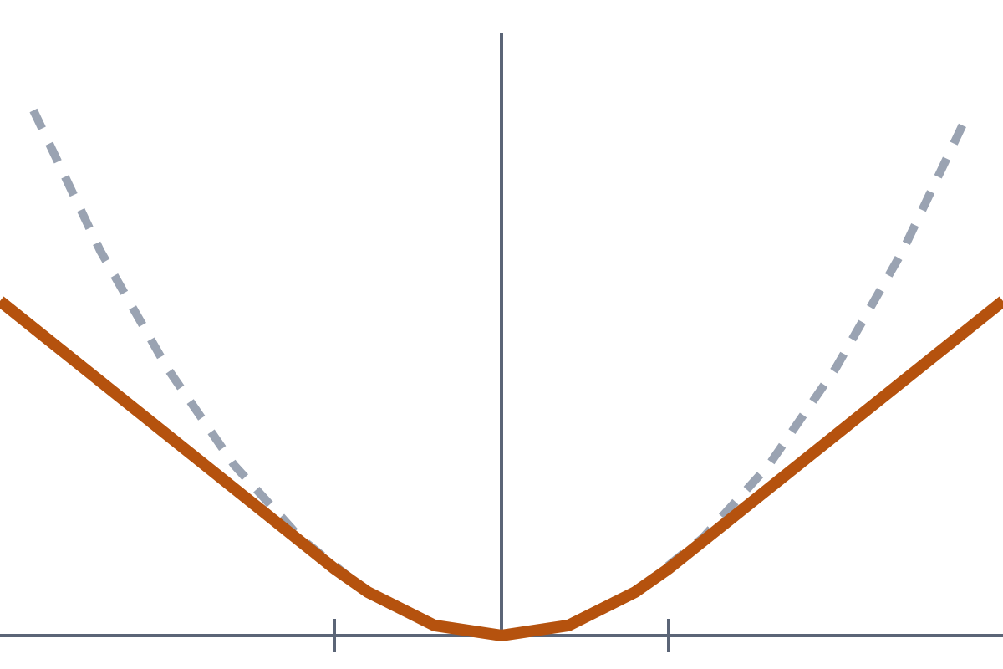
Huber loss on the TD error
LOSS
ℓ(δ) = ½·δ² if |δ| ≤ 1
ℓ(δ) = |δ| − ½ otherwise
L = Σ ℓ(δᵢ) over the 32 samples
δ | ℓ(δ) | dℓ/dQ
0.296 | 0.044 | −0.296
2.5 | 2.0 | −1 (capped)
The gradient is −δ, clipped to [−1, 1]: one surprising sample cannot yank the weights. This is the Nature paper’s error clipping.
Dashed grey: squared error ½δ². Orange: Huber, the same near zero and linear beyond |δ| = 1 (ticks). Horizontal axis: δ from −3 to 3.
How the Pong DQN learns · 10 / 16
Notes:
The project uses PyTorch smooth_l1_loss with beta 1, which is the Huber loss. With the Nature RMSProp optimizer the per-sample losses are summed over the minibatch rather than averaged, matching the released Nature code. The Loss chart in the UI plots this L for every update.

Slide 11

The error flows back from one output only
BACKPROPAGATION
Loss L
Q(s, a)
Dense 512
Conv 3
Conv 2
Conv 1
Pick one output. gather() keeps only Q(s, a) for the action taken. The other five outputs get gradient 0.
Target is a constant. y is computed under no_grad on the target network, so nothing flows into it.
Output layer. ∂L/∂Q = −clip(δ, −1, 1). Row a of the last layer gets ∂L/∂W[a] = ∂L/∂Q · h, where h is the 512 hidden activations.
Chain rule backwards. The error passes through Dense 512, Conv 3, Conv 2 and Conv 1. ReLU lets it through only where its input was positive.
Add up the batch. Gradients from all 32 samples are summed, then one optimizer step updates all 1.69 M weights.
How the Pong DQN learns · 11 / 16
Notes:
loss.backward() in PyTorch does all of this automatically. The arrows show the backward direction: from the loss back to the first convolution. Only the online network receives gradients; the target network is copied from it every 1,000 updates.

Slide 12
Centered RMSProp, as in the Nature code
THE WEIGHT UPDATE
m ← 0.95·m + 0.05·g
v ← 0.95·v + 0.05·g²
θ ← θ − 0.00025 · g / √(v − m² + 0.01)
Setting | Value
Learning rate | 0.00025
Decay | 0.95
ε in the root | 0.01
Batch size | 32
Updates per game | 128
Target copy | every 1,000
Extra gradient clip | none
g is a weight’s gradient. m and v track its running mean and mean square, so v − m² is its recent variance.
Weights with noisy gradients take smaller steps; steady ones take larger steps.
How the Pong DQN learns · 12 / 16
Notes:
This is NatureRMSprop in optimizer.py. The 0.01 inside the square root stops tiny variances from creating huge steps. Huber already caps each sample's gradient at 1, so the lab disables any extra gradient-norm clipping.

Slide 13
One update, in the project code
LEARNER.PY
predicted = online(states).gather(1, actions[:, None]).squeeze(1)
# no_grad: the target network is not trained here
next_q = target(next_states).max(dim=1).values
targets = rewards + gamma * (~terminated) * next_q
loss = smooth_l1_loss(predicted, targets, reduction="none").sum()
optimizer.zero_grad()
loss.backward() # backpropagation through the online network
optimizer.step() # centered RMSProp
if update_count % 1000 == 0: target ← online
Each learning phase runs this 128 times. The UI charts loss, mean |δ| and mean Q for every one of those updates.
How the Pong DQN learns · 13 / 16
Notes:
Simplified from DQNLearner.update and the training loop in pong_session.py. The target copy check uses the cumulative update count, which carries across games.

Slide 14
Why it still plays badly
YOUR SESSIONS SO FAR
93–96%
128
≈ 8
random moves
updates per game
games to first copy
ε was still 0.93 to 0.96 in games 2 to 4. Whatever the network learned, it was rarely allowed to use it.
DQN’s usual pace, one update per four decisions, would give about 450 for a 1,800-decision game.
The target network is first refreshed after 1,000 updates. Until then targets come from the random starting network.
Each session had 3 or 4 games, some only 20 s long, and each started from random weights. Weak play at this stage is expected, not a bug.
How the Pong DQN learns · 14 / 16
Notes:
Numbers come from the saved sessions in experiments/pong_sessions. The learning code is working: the smoke test shows real weight-changing updates. The agent simply has had a tiny fraction of the experience and updates DQN needs, and it was still exploring almost all the time.

Slide 15
How many full 2-minute games?
ESTIMATE
Milestone | What it takes | 128 updates / game | 450 updates / game
Exploration down to ε = 0.05 | 20,000 decisions | ≈ 11 | ≈ 11
Replay full | 20,000 transitions | ≈ 11 | ≈ 11
First target copy | 1,000 updates | ≈ 8 | ≈ 3
Clear ball tracking (rough) | ~25k updates, ~100k decisions | ≈ 200 | ≈ 55
Competitive rallies (rough) | ~125k updates, ~500k decisions | ≈ 1,000 | ≈ 280
At current settings: about 200 games, roughly 7 hours of play, before clear ball tracking.
With ~450 updates per game: about 55 games, roughly 2 hours. The experience itself is then the limit.
The first three rows follow from the lab settings. The shaded rows are order-of-magnitude estimates from typical single-agent DQN Pong runs; a human opponent is less predictable.
How the Pong DQN learns · 15 / 16
Notes:
Games are counted at about 1,800 decisions each. The shaded rows convert typical single-agent DQN Pong learning curves into games: updates divided by updates per game, and decisions divided by 1,800. Treat them as rough planning numbers, not guarantees. Learning time on CPU adds to the play time.

Slide 16
What would make it learn faster
NEXT STEPS
More updates per game
Faster exploration decay
Set updates_per_match to about 450, DQN’s usual pace. The config allows up to 2,048. Cost: a longer learning phase on CPU.
epsilon_decisions = 10,000 lets the network act on its estimates after about 6 games instead of 11.
Pretrain before the demo
Set the right expectation
Run thousands of games against a scripted paddle that follows the ball, then import that checkpoint. Not built yet.
A few games demonstrate real updates and changing Q-values. A strong player needs hundreds of games of experience.
How the Pong DQN learns · 16 / 16
Notes:
The first two changes are configuration only: both values are accepted by the session config today. Pretraining against a scripted opponent would be new code, but it uses the same two-player environment and action map, so the checkpoint would be compatible with the lab.

